Slide 1
Chapter 5. Microbial Diversity Part 2: Eucaryotic Microbes
Instructor:
Bertha Escobar-Poni, MD

Slide 2
Chapter 5 Outline
Introduction
Algae
Characteristics and Classification
Medical Significance
Protozoa
Characteristics
Classification and Medical Significance
Fungi
Characteristics
Classification
Medical Significance
Lichens
Slime Moulds

Slide 3
Algae Characteristics and Classification
Algae are photosynthetic, eucaryotic organisms.
All algal cells consist of cytoplasm, a cell wall (usually), a cell membrane, a nucleus, plastids, ribosomes, mitochondria, and Golgi bodies.
Some have a pellicle, a stigma, and/or flagella
Algae range in size from unicellular microorganisms (e.g., diatoms) to large, multi-cellular organisms (e.g. seaweeds or kelp).
Algae produce energy by photosynthesis.
Some may use organic nutrients.

Slide 4
Algae Characteristics and Classification, cont.
Algae may be arranged in colonies or strands and are found in fresh and salt water, in wet soil, and on wet rocks.
Most algal cell walls contain cellulose.
Depending on their photosynthetic pigments, algae are classified as green, golden, brown, or red algae.
Algae include: diatoms, dinoflagellates, desmids, Spirogyra, Chlamydomonas, Volvox, and Euglena.
Algae are an important source of food, iodine, fertilizers, emulsifiers, and stabilizers and gelling agents for jams and culture media.

Slide 5
Common Pond Water Algae and Protozoa
Amoeba sp.
Euglena sp.
Stentor sp.
Vorticella sp.
Volvox sp.
Paramecium sp.
B and E are algae.
A, C, D, and F are protozoa.

Slide 6
Algae: Medical Significance
One genus of algae, Prototheca, is a very rare cause of human infections
Causes protothecosis
Algae in several other genera secrete toxic substances called phycotoxins
Poisonous to humans, fish, and other animals
If ingested by humans, the phycotoxins produced by the dinoflagellates that cause “red tides” can lead to a disease called paralytic shellfish poisoning

Slide 7
Protozoa Characteristics
Protozoa are nonphotosynthetic, eucaryotic organisms.
Most protozoa are unicellular and free-living; found in soil and water.
Most protozoa are more animal-like than plant-like.
All protozoal cells possess a variety of eucaryotic structures/organelles.
Protozoa cannot make their own food; they ingest whole algae, yeasts, bacteria, and smaller protozoa for nutrients.

Slide 8
Protozoa Characteristics, cont.
Protozoa do not have cell walls, but some possess a thickened cell membrane called a “pellicle,” which serves the same purpose – protection.
A typical protozoan life cycle has 2 stages – a trophozoite and a cyst.
The trophozoite is the motile, feeding, dividing stage.
The cyst is the nonmotile, dormant, survival stage.
Some protozoa are parasites.
Parasitic protozoa cause many human diseases, such as malaria, giardiasis, and trypanosomiasis.

Slide 9
Protozoa Characteristics (continued)
Protozoa are divided into groups, based on their method of locomotion:
Amebae move by means of pseudopodia (“false feet”) – example: Entamoeba histolytica, the cause of amebic dystentery.
Ciliates move by means of hairlike cilia – example: Balantidium coli, the cause of balantidiasis.
Flagellates move by means of whiplike flagella – example: Giardia lamblia, the cause of giardiasis.
Sporozoa have no visible means of locomotion – example: Plasmodium spp., which cause malaria.

Slide 10
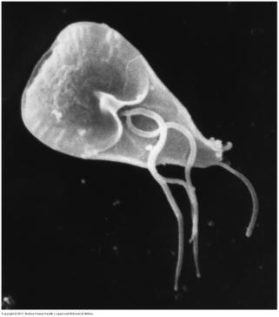
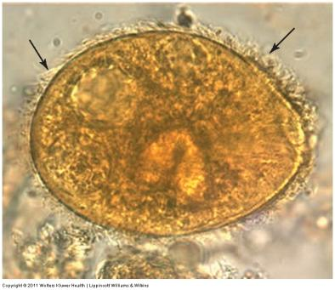
Protozoa That Cause Human Diseases
Photomicrograph of a B. coli trophozoite
(Arrows are pointing to the cilia).
SEM of a Giardia lamblia trophozoite.

Slide 11
Fungi Characteristics
The study of fungi is called mycology; scientists who study fungi are called mycologists.
Fungi are found virtually everywhere.
Some fungi are harmful, some are beneficial.
Fungi represent a diverse group of eucaryotic organisms that include yeasts, moulds, and fleshy fungi (e.g., mushrooms).
Fungi are the “garbage disposers” of nature.
Fungi are not plants – they are not photosynthetic.

Slide 12
Fungi Characteristics, cont.
Fungal cell walls contain a polysaccharide called chitin.
Some fungi are unicellular, while others grow as filaments called hyphae.
Hyphae intertwine to form a mass called a mycelium.
Some fungi have septate hyphae (the hyphae are divided into cells by cross walls or septa).
Some fungi have aseptate hyphae (the hyphae do not have septa).
Whether or not a fungus has aseptate or septate hyphae is an important clue to its identification.

Slide 13
Fungi - Reproduction
Depending on the species, fungal cells can reproduce by budding, hyphal extension, or the formation of spores.
There are 2 general categories of spores:
Sexual spores
Asexual spores (also called conidia)
Some fungi produce both asexual and sexual spores.
Fungal spores are very resistant structures.

Slide 14
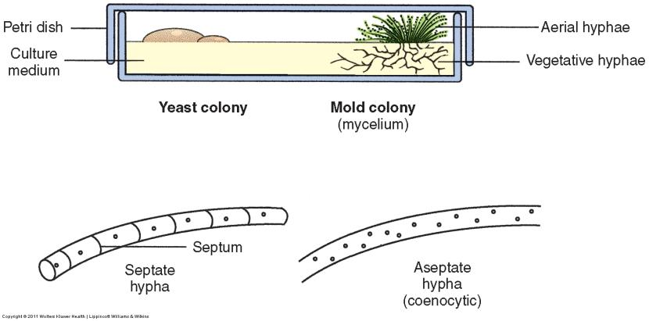
Fungal Colonies and Terms Relating to Hyphae

Slide 15
Fungi - classification
Classification of fungi is based primarily on their mode of sexual reproduction and the type of sexual spore they produce.
The 5 phyla of fungi are:
Zygomycotina,
Chytridiomycotina,
Ascomycotina,
Basidiomycotina, and
Deuteromycotina.
Deuteromycotina or Deuteromycetes include the medically important moulds such as Aspergillus and Penicillium.
Fungi in this phylum have no mode of sexual reproduction or the mode of sexual reproduction is not known.

Slide 16
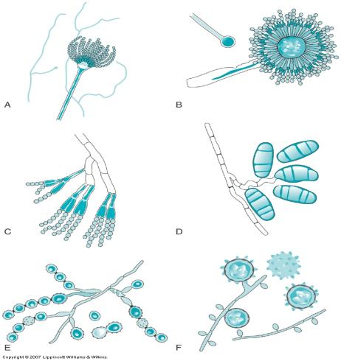
Microscopic Appearance of Various Fungi
Aspergillus fumigatus
Aspergilus flavus
Penicillium sp.
Curvularia sp.
Scopulariopsis sp.
Histoplasma capsulatum
Copyright © 2011 Wolters Kluwer Health | Lippincott Williams & Wilkins

Slide 17
Fungi: Yeasts
Yeasts are eucaryotic, unicellular organisms that lack mycelia.
Individual yeast cells, also referred to as blastospores or blastoconidia, can only be observed using a microscope.
Yeasts usually reproduce by budding, but occasionally by a type of spore formation.
A string of elongated buds is known as a pseudohypha (not really a hypha).
Some yeasts produce thick-walled, spore-like structures called chlamydospores (or chlamydoconidia).

Slide 18
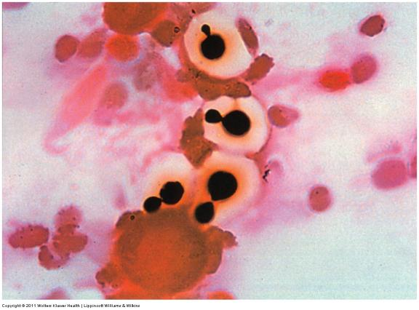
Gram-Stained Clinical Specimen Containing Budding Yeast Cells

Slide 19
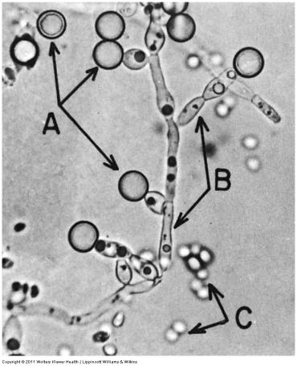
Microscopic Appearance of the Yeast Candida albicans
A = Chlamydospores
B = Pseudohyphae
C = Budding yeast cells
(blastospores)

Slide 20
Fungi: Yeasts, cont.
Colonies of C. albicans on Blood Agar
Yeasts are found in soil and water and on the skins of many fruits and vegetables.
Yeasts have been used for centuries to make wine and beer.
Saccharomyces cerevisiae is a yeast used in baking.
Candida albicans is the yeast most frequently isolated from human clinical specimens, and is also the fungus most frequently isolated from human clinical specimens.

Slide 21
Fungi: Yeasts, cont.
Gram-Stained Clinical Specimen Containing Yeasts, Bacteria, and White Blood Cells
Yeast colonies may be difficult to distinguish from bacterial colonies.
A simple wet mount can be used to differentiate yeast colonies from bacterial colonies.
Yeasts are larger than bacteria and are usually oval-shaped.
Yeasts are often observed in the process of budding.
Bacteria do not bud.

Slide 22
Fungi: Moulds
Often spelled “molds.”
Moulds are often seen in water and soil and growing on food.
Moulds produce cytoplasmic filaments called hyphae.
Aerial hyphae extend above the surface of whatever the mould is growing on.
Vegetative hyphae grow beneath the surface.
Reproduction is by spore formation, either sexually or asexually, on the aerial hyphae (also known as reproductive hyphae).

Slide 23
Fungi: Moulds, cont.
Moulds have great commercial importance.
Some produce antibiotics.
Examples: Penicillium and Cephalosporium
Some moulds are used to produce large quantities of enzymes that are used commercially.
The flavor of cheeses like bleu cheese, Roquefort, camembert, and limburger are due to moulds that grow in them.

Slide 24
Fungi: Fleshy Fungi
Include mushrooms, toadstools, puffballs and bracket fungi
Consist of a network of filaments or strands (the mycelium) that grows in soil or on rotting logs
The fruiting body that grows above the ground forms and releases spores
Some mushrooms are edible; some are extremely toxic

Slide 25
Fungi - Medical Significance
A variety of fungi including yeasts, moulds, and some fleshy fungi, are of medical, veterinary and agricultural importance because of the diseases they cause in humans, animals, and plants.
The infectious diseases of humans and animals that are caused by moulds are called mycoses.
Fungal infections of humans are categorized as superficial, cutaneous, subcutaneous, and systemic mycoses.

Slide 26
Superficial and Cutaneous Mycoses
Superficial mycoses are fungal infections of the outermost areas of the human body – hair, nails and epidermis.
Cutaneous mycoses are fungal infections of the living layer of the skin, the dermis.
A group of moulds collectively referred to as dermatophytes cause tinea (“ringworm”) infections.
Note that “ringworm” infections have nothing to do with worms.
The yeast, Candida albicans, can also cause cutaneous, oral, and vaginal infections.

Slide 27
Subcutaneous and Systemic Mycoses
Subcutaneous and systemic mycoses are more severe types of fungal infections.
Subcutaneous mycoses are fungal infections of the dermis and underlying tissues. Example: Madura foot.
Systemic mycoses are fungal infections of the internal organs of the body.
Spores of some pathogenic fungi may be inhaled with dust from contaminated soil or dried bird or bat feces. They may also enter through wounds of the hands and feet.

Slide 28
Subcutaneous and Systemic Mycoses
Examples of deep-seated pulmonary infections include blastomycosis, coccidioidomycosis, cryptococcosis, and histoplasmosis.
Inhalation of common bread moulds like Rhizopus and Mucor spp. can cause disease and even death in immunosuppressed patients.
Diagnosis of mycoses is accomplished by culture techniques and immunodiagnostic procedures.
Yeasts are identified using a series of biochemical tests.
Moulds are identified using a combination of macroscopic and microscopic observations.

Slide 29
Dimorphic Fungi
A few fungi, including some pathogens, can live as either yeasts or moulds, depending on growth conditions.
This phenomenon is known as dimorphism and the fungi are called dimorphic fungi.

Slide 30
Dimorphic Fungi
When grown in vitro at body temperature (37ºC), dimorphic fungi grow as yeasts and produce yeast colonies.
When grown in vitro at room temperature (25ºC), dimorphic fungi exist as moulds, producing mould colonies.
In vivo, dimorphic fungi exist as yeasts.

Slide 31
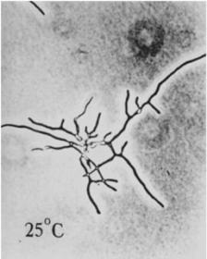
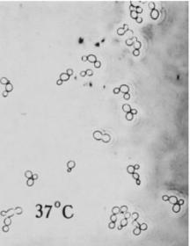
Dimorphic Fungi, cont.
Dimorphic fungi that cause human diseases include:
Histoplasma capsulatum (histoplasmosis)
Sporothrix schenckii (sporotrichosis)
Coccidioides immitis (coccidioidomycosis)
Blastomyces dermatitidis (blastomycosis)

Slide 32
Lichens and Slime Moulds
Lichens are observed as colored, often circular patches on tree trunks and rocks.
Lichens are composed of an alga and a fungus living in a mutualistic relationship.
Lichens are classified as protists.
Slime moulds are found in soil and on rotting logs.
Slime moulds have both fungal and protozoal characteristics.
Slime moulds are classified as protists.

Slide 33
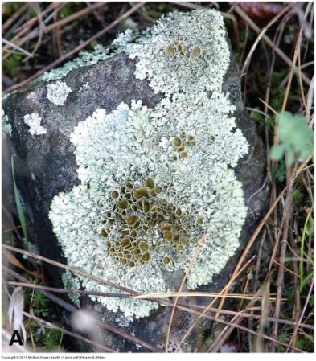
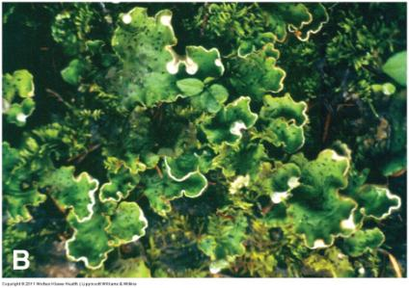
Different Types of Lichens

