Slide 1
RSTH 421 Perinatal & Pediatric Respiratory Care Prenatal Risk factors
Arthur B. Marshak, EdD, MS, RRT, RPFT
Department of Cardiopulmonary Sciences
Loma Linda University
Fall 2011

Slide 2
Prenatal Risk Factors and Maternal History
Objectives:
Identify the infant mortality rate in the U.S. and compare it to other developed countries.
Identify antepartum maternal factors which indicate high risk for adverse fetal outcomes.
Define common abbreviations used when discussing prenatal and maternal risk factors.
Recognize prenatal assessments or tests which indicate abnormalities of the fetus or the fetal-maternal unit.
Identify abnormal fetal heart rate patterns and their probable causes.
Identify normal and abnormal fetal presentations at delivery.

Slide 3
Worldwide Infant Mortality Rates

Slide 4
Prenatal Risk Factors and Maternal History
Mortality Trends
Countries with well organized systems for perinatal care have better mortality and morbidity statistics.
Decreased deaths related to presence of NICU, maternal ICU and high risk obstetric programs.
Mortality and morbidity statistics improve as access to appropriate healthcare increases.

Slide 5
Infant Mortality
3 Leading causes of infant death:
Congenital abnormalities
Pre-maturity and low birth weight
Sudden Infant Death Syndrome

Slide 6
Infant Mortality
Differs among Races
Increasing order
Asian & Pacific Islanders
Mexicans
Caucasians
Puerto Ricans
American Indians
African-Americans
Predisposing factors
Prenatal care only after 1st Trimester
Teenagers and >40 y/o
Unmarried
HS not completed
Smoker during pregnancy
Multiple births
Pre-term infant
Low birth weight

Slide 7
Toxic Habits during Pregnancy
Maternal habits should be assessed early in pregnancy.
Substance abuse found in ~10%.
Most frequent:
Alcohol
Cigarette smoking
Cocaine

Slide 8
Alcohol abuse in pregnancy
Potent teratogen
Fetal alcohol syndrome – 1973
Usually seen when 4-6 drinks/day consumed
Characterized by:
Mental retardation
Pre and post-natal growth restriction
Brain, cardiac, spinal and craniofacial anomalies

Slide 9
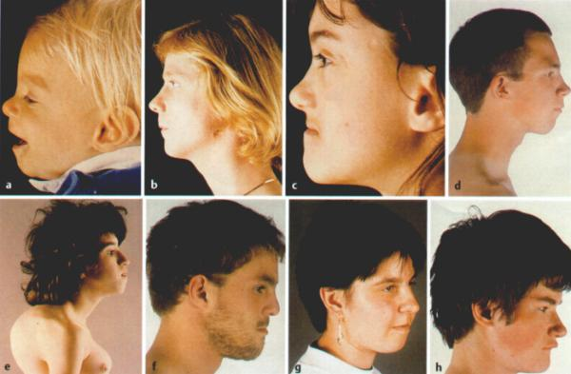
Fetal alcohol syndrome

Slide 10
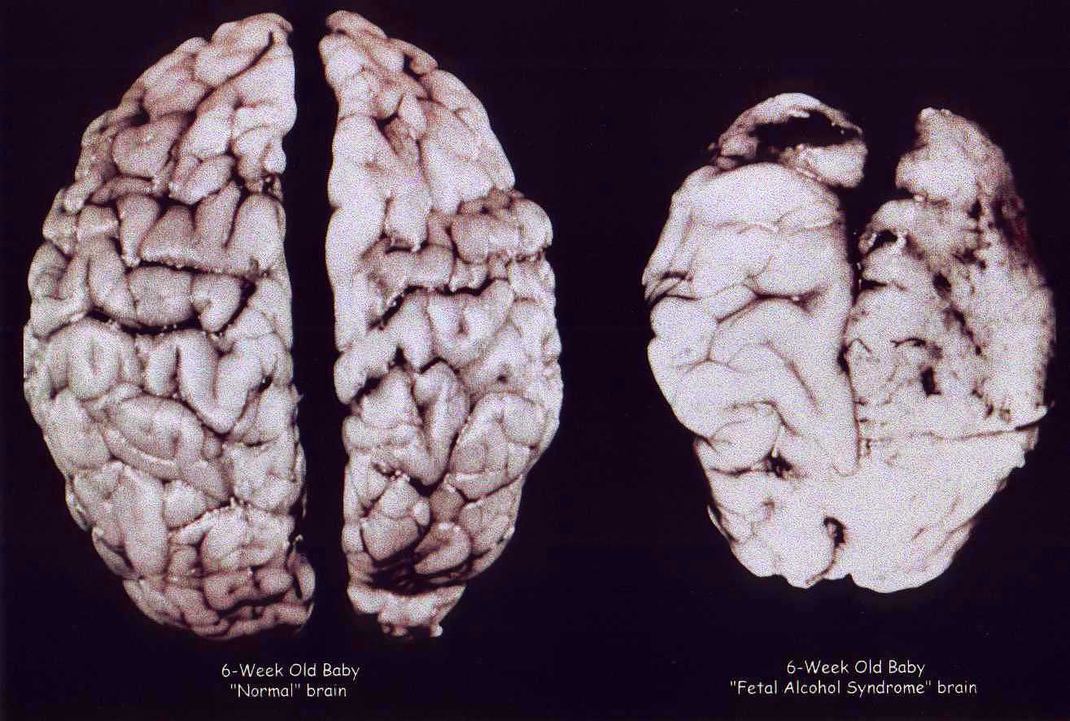
Fetal alcohol syndrome

Slide 11
Effects of cigarette smoking
Cigarette smoke causes:
An increase in CO and nicotine to the fetus
A predisposition for lower birth weight
Infants weigh ~200g less than from non-smokers
Higher risk for and incidence of:
Premature pre-term rupture of membranes
Placential abruption
Placenta previa
SIDS

Slide 12
Cocaine
Potent constrictor of blood vessels
May cause numerous medical complications:
Myocardial infarction, stroke, seizures, bowel ischemia, death.
Placental abruption, pre-term delivery, growth restriction
Congenital malformations of limbs, heart, brain, GI
Infants suffer significant withdrawals, and are SGA

Slide 13
History of Previous Births
Difficulty with previous births places mother in high risk category for future pregnancies
Previous problems include:
Delivery by cesarean section
Miscarriage
Premature or postmature birth
Fetal or neonatal death
Infant of high or low birth weight
Infant requiring intrauterine or neonatal blood transfusion

Slide 14
Pregnancy-induced Hypertension
Hypertensive disease complicates 6-8% of pregnancies.
Second only to embolism as cause of maternal death

Slide 15
Maternal Diabetes Mellitus
Classified as pregestational or gestational
Increased risk for or development of:
Diabetic ketoacidosis
Proliferative retinopathy
Preeclampsia/eclampsia
Unexplained fetal death during 3rd trimester
Major fetal structural abnormalities (10-15%)
Deliver infants with birth weights > 4000g

Slide 16
Classification of Diabetes

Slide 17
Maternal Infections
Most notable examples:
T = toxoplasma – raw/undercooked meat, cat feces
O = others – HIV (see next slide)
R = rubella – cardiac defects, deafness, normal
C = cytomegalovirus – bleeding & CNS disorders
H = herpies simplex – types 1 & 2 may be either disseminated (D) or localized (L), may cause death (D) or affect eyes, skin, CNS (L)

Slide 18
Maternal HIV
1-8/1000 pregnant women in US carry HIV
Asymptomatic HIV does not appear to alter course of pregnancy
Clinical AIDS increases risk of:
Hepatitis, CMV, Toxoplasmosis, Tuberculosis
Transmission of HIV to fetus (~30%)
Zidovudine (antiretroviral) ↓ to 8.3%
Zidovudine + C-Section: ↓ to 2%
HIV transmitted through breast milk

Slide 19
Umbilical cord abnormalities
~55 cm in length
2 arteries, 1 vein
3% have only 1 artery
18% incidence of major fetal malformations
Long cord associated with cord prolapse
Short cord with placental abruption

Slide 20
Placental abnormalities
Caused by:
Hypertension
Advanced maternal age
Multiparity
Preterm PROM
Trauma
Cigarette smoking
Cocaine abuse
Vaginal bleeding

Slide 21
Inadequate Amniotic Fluid Volume
Potter Sequence: Potter sequence results from oligohydramnios (decreased amniotic fluid). The phenotype of flattened facies, wide nasal bridge, positional abnormalities of the hands and feet, and hypoplastic lungs result from fetal compression and decreased fetal movement due to the lack of amniotic fluid. The major cause of death in the newborn is pulmonary hypoplasia

Slide 22
Polyhydramnios
Amniotic Fluid Index > 24
Associated with fetal malformations:
Anencephaly
Esophageal atresia
Tracheoesophageal fistula
Maternal diabetes
Over-distends uterus leading to PROM or preterm labor

Slide 23
Premature Rupture of Membranes (PROM)
Rupture premature if occurs > 24 hours before delivery
> in premature infants
Increases likelihood of fetal infection
May require steroids to accelerate lung maturity, hospitalization, early delivery

Slide 24
Prematurity
Usually < 37 weeks gestational age
Highest risk for pulmonary problems
Inadequate surfactant levels lead to HMD
Difficulty in absorbing nutrients
Problems with thermoregulation
Intraventricular hemorrhage
Most common: asphyxia, HMD, infection

Slide 25
Intrauterine Growth Retardation
aka SGA
Initially growth due to increase in cell numbers
Later due to increase in cell size
Often chronically hypoxic inutero
Difficulty withstanding long labor
Predisposed to Meconium aspiration

Slide 26
Postmaturity
Normal gestational range is 38 – 42 weeks
> 42 weeks classified as postmature
Placental function declines
Meconium staining likelihood increases
Physical signs:
Dry, cracked skin, long nails
Loose skin, excessive scalp hair

Slide 27
Antenatal Assessment
History and physical of mother
Ultrasound
Amniocentesis
Nonstress test and contraction stress test
Fetal biophysical profile

Slide 28
Fetal Ultrasound
Widely used
Noninvasive
UHF sound waves to:
Diagnose fetal abnormalities
Localize placenta within uterus
Measure AF volume
Estimate fetal growth
Assess fetal status

Slide 29
Amniocentesis
Most commonly performed invasive procedure
AF concentrations determine status of pregnancy
Fetal abnormalities
Women > 35 y/o

Slide 30
Assessment of Lung Maturity
Amniotic fluid assessed
2 Pulmonary surfactants
Ratio of Lecithin to Sphingomyelin
>2.0 predicts mature lungs
<1 severe lung immaturity
> 2.0 usually seen after 34 weeks gestational age

Slide 31
Lung Maturity Tests cont.
“Shake test”
Amniotic fluid mixed with alcohol and shaken
Lungs mature if ring of bubbles present on surface after 15 minutes
Level of Saturated Phosphatidylcholine (SPC)
> 500μg/dL - ↓ incidence of HMD
< 500μg/dL - ↑ incidence of HMD

Slide 32
Nonstress Test
Monitor fetal well being
FHR changes when fetus moves
N = ↑ > 15 bpm for >15 seconds
Highly correlates with uteroplacental function

Slide 33
Fetal Maturity Test
Chorionic villus sampling
1st trimester
Results are quick
Tissue good for DNA analysis
High miscarriage rate
Risk of hemorrhage
Risk of maternal sepsis

Slide 34
Contraction Stress Test
Contractions stimulated by injecting mother with dilute oxytocin
Fetal PO2 ↓ with contractions
N = no fall in FHR, may ↑
+ = ↓ in FHR with contractions.
+ Seen with uteroplacental insufficiency

Slide 35
BPP Scoring
Likened to APGAR score
Five determinants assessed and scored 0 – 2
Four assessed by ultrasonography
8 – 10 Normal
4 – 6 Equivocal, repeat test within 24 hrs
0 – 4 Abnormal, poor perinatal outcomes

Slide 36
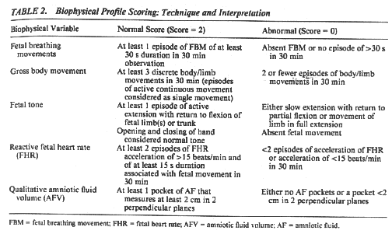
Fetal Biophysical Profile (BPP)

Slide 37
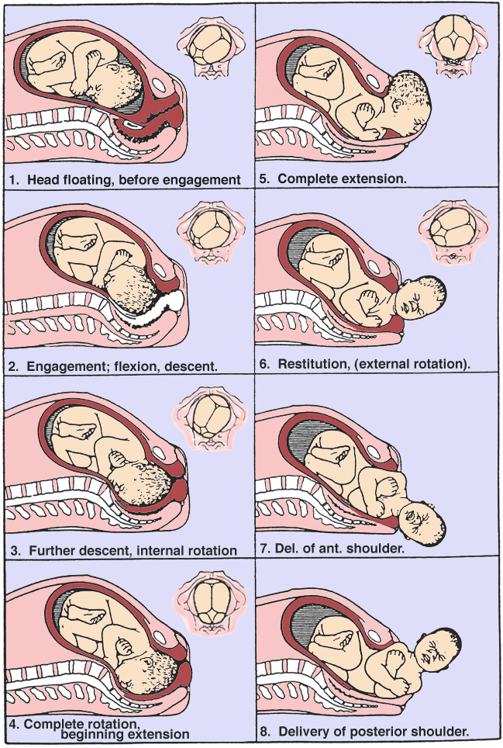
Normal Delivery

Slide 38
Breech Delivery
Occurs when infant not in vertex presentation
Increases risk of trauma and asphyxia
Instruments may be needed for assistance
Cesarean section if mother or fetus in distress

Slide 39
Appendix I
Relationship of Weight to Gestational Age:
Within the 10th – 90th percentile of weight – AGA
< the 10th percentile of weight for age – SGA
> the 90th percentile of weight for age – LGA
Weight Categories:
Low Birth Weight: < 2500g
Very Low Birth Weight: 1000 – 1499g
Extremely Low Birth Weight: 500 – 999g

Slide 40
APPENDIX II Causes for Inappropriate Growth
SGA:
Maternal hypertension
Multiple births
Smoking
Malnutrition
Abnormal uterine anatomy
Fetal Alcohol Syndrome
Cocaine abuse
Congenital defects
Fetal infection
SGA outcomes:
Higher mortality than AGA
Higher risk of congenital abnormalities
Higher risk of abnormal brain development
Polycythemia
Hypoglycemia

Slide 41
APPENDIX II Causes for Inappropriate Growth
LGA:
Genetic predisposition
Diabetic mother
Outcomes for LGA:
Birth trauma
Hypoglycemia
Hypocalcaemia
Hyperbilirubinemia

Slide 42
T
H
E
B
E
G
I
N
N
I
N
G
T
H
E
E
N
D

Slide 43
ThermoRegulation and the Neonate
Heat Loss

Slide 44
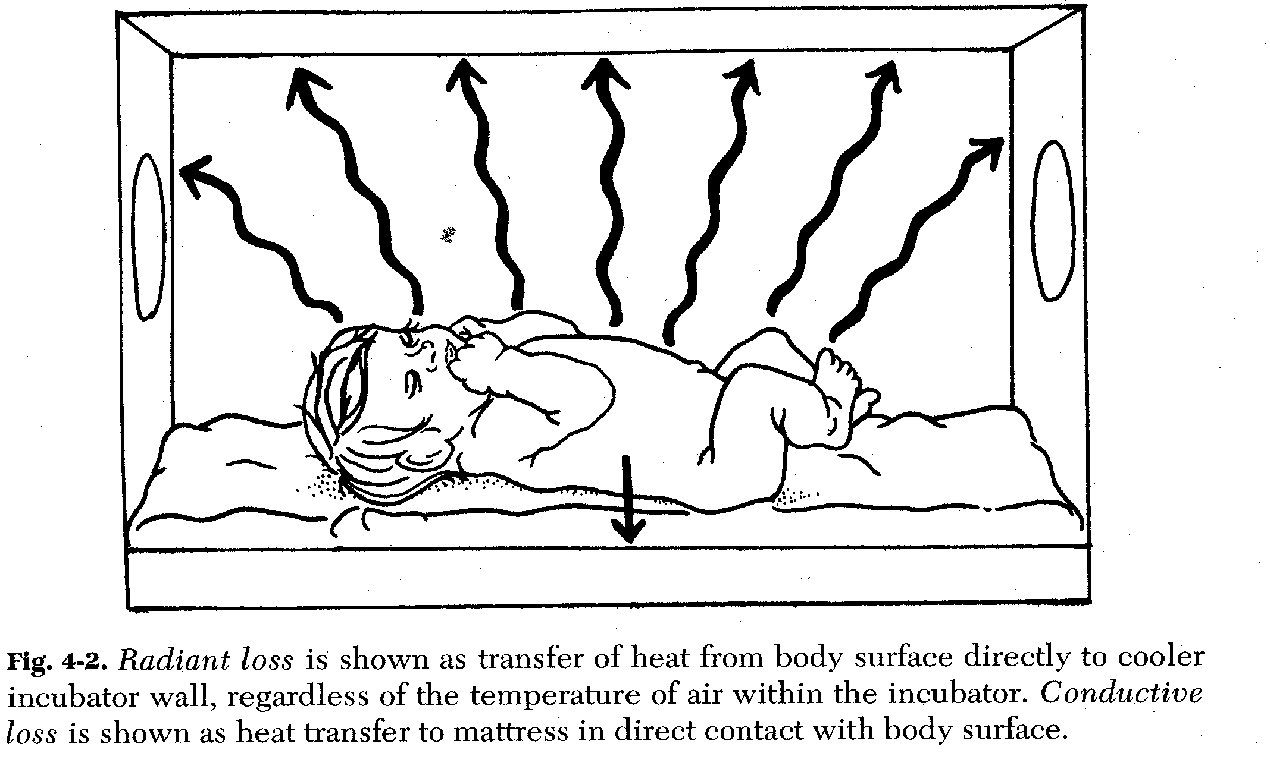

Slide 45
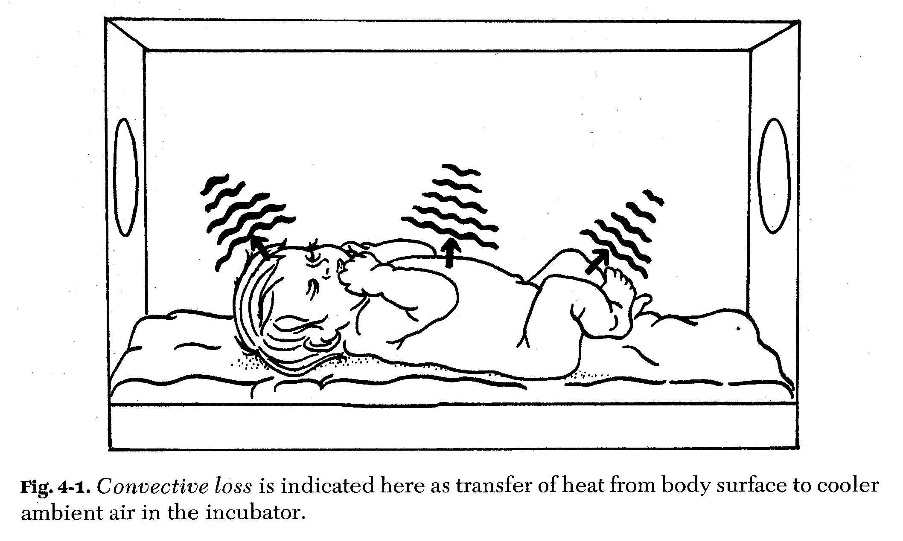

Slide 46
