Slide 1

EPDM 509
Classification and
Surveillance
Data Sources
Lecture 1B
R Knutsen
Notes:
1
In this lecture we will look at data sources used in epidemiology and how we obtained the data. Disease surveillance is an essential part of Public Health because much of the morbidity and mortality information we use come from different surveillance programs. To be able to collect, process and use the information in an orderly manner, we need some way of grouping or classifying them. Classification is to order into groups or assign to pre-designated classes based on common characteristics.

Slide 2
Objectives
You will be able to:
Identify common population health status indices
Calculate and interpret selected health status measures
Describe health surveillance measures
Locate sources of health data
Notes:
2
The objectives for this lecture is to make you able to
Identify common population health indicators (e.g. infant mortality)
Calculate and interpret health status measures (e.g. crude mortality “rate”)
Describe health surveillance measures, and
Locate sources of health data

Slide 3
Physicist Kelvin
I often say that when you can measure what you are speaking about, and express it in numbers, you know something about it;
but when you cannot express it in numbers, your knowledge is of a meager and unsatisfactory kind;
it may be the beginning of knowledge, but you scarcely, in your thoughts, advanced to the stage of Science, whatever the matter may be.
Notes:
3
Lord William Thompson Kelvin (1824-1907) is known for defining the “absolute zero”, the null point where nothing moves. Kelvin used the reciprocal of the expansion coefficient of gas per degree Celsius relative to the ice point, and found that the absolute zero was -273 degree Celsius. Today we know this null point to be -273.15°C, or -459.67°F.
Kelvin could not envision science without numbers, and that is also true in epidemiology today.

Slide 4
Three statisticians go deer hunting with bows and arrows.
They spot a big buck and take aim.
One shoots and his arrow flies off ten feet to the left.
The second shoots and his arrow goes ten feet to the right.
The third statistician jumps up and down yelling: “We got him! We got him!”
Notes:
4
This little story is about three statisticians who went deer hunting with bows and arrows. Spotting a buck two of them shoots, and both miss the target, by ten feet, but on opposite sides of the dear. The third statistician is excited, because on the average, they hit the target. This illustrates how statistics and probabilities may work in problem-solving. “On average” imply that epidemiology and statistics are dealing with populations, not individuals.

Slide 5
Disease Classification Systems
  International Classification of Disease
  (ICD-10)
    Used worldwide in hospital settings
  Internat. Classification of Primary Care (ICPC)
    Used extensively in primary health care
    Includes many symptoms-based diagnosis
  Internat. Histological Classification of Tumors
  (IHCT)
  Internat. Classification of Diseases for Oncology
  (ICD-O)
Notes:
5
In order to apply statistics on disease distributions, we first need to arrange them into groups of common characteristics. The classification system used worldwide today in hospital settings is the International Classification of Disease, revision 10 (ICD-10). This standardization makes it possible to compare results from different places and countries. There are also such classification systems for Primary Care (ICPC), for Histological classification (IHCT) and for Oncology (ICD-O).

Slide 6
ICD-10 Codes - Groups
A00 - B99 Infectious and Parasitic Diseases
C00 - D49 Neoplasms
D50 - D89 Blood and Blood Forming Organs
E00 - E89 Endocrine Nutritional and Metabolic Diseases
F01 - F99 Mental, Behavioral and Neurodevelopmental Disorders
G00 - G99 Nervous System
H00 - H59 Eye and Adnexa
H60 - H95 Ear and Mastoid
I00 - I99 Circulatory System
J00 - J99 Respiratory System
K00 - K95 Digestive System
L00 - L99 Skin and Subcutaneous Tissue
M00 - M99 Musculoskeletal System and Connective Tissue
N00 - N99 Genitourinary System
O00 - O9A Pregnancy, Childbirth, and Puerperium
P00 - P96 Certain Conditions Origination in the Perinatal Period
Q00 - Q99 Congenital malformations, deformations, chromosomal abnormalities
R00 - R99 Symptoms, signs, abnormal, clinical and laboratory findings
S00 - T88 Injury, poisoning, certain other consequences of external causes
V00 - Y99 External causes of Morbidity
Notes:
6
This is an overview of ICD-10 code groups.

Slide 7
Precise diagnosis (disease classification)
Precision of classification-crucial for measurement of disease occurrence
  Example: Myocardial Infarction (MI)
  1. Old criteria:
    - Acute, retrosternal pain
    - No effect of Nitro
    - Increasing sedimentation rate
2. New criteria:
  - Acute, retrosternal pain
  - ECG changes
  - Imaging (MPS, eccocardiography, MRI)
  - Enzyme changes (Troponin, CKMB, LDH)
Notes:
7
In research as well as in clinical work, it is of utmost importance that the diagnosis (i.e. disease classification) is correct and precise. Precision of disease classification is crucial for the measurement/assessment of disease occurrence.
In the example of MI, the old criteria was not very precise. Acute retrosternal pain with no effect of Nitro may even happen if the pain originate in the muscles of the breast wall. Moreover, the sedimentation rate may be elevated due to a host of causes. The new criteria, however, are much more precise, adding ECG changes, Imaging (MPS=Myocardial Perfusion Scintigraphy), eccocardiography, MRI and several enzyme changes, of which Troponin is the newest and may remain elevated for 7-14 days following MI.
MPS = Myocardial Perfusion Scintigraphy
MRI = Magnetic Resonance Investigation
Troponin (I, T) = May remain elevated for 7-14 days following MI.
CK = (creatine kinase). ↑ to a peak within 18-24 h of muscle injury. Originates from:
- Brain (BB isomer) ,
- Skeletal muscle (MM isomer),
- Myocardium MB isomer.
LDH (α-hydroxybutaric dehydrogenase) = maximal at 4-5 days of muscle injury.

Slide 8
Classification of exposure
  Precision (Sharply defined and detailed exposure information)
    - crucial for the quality of epidemiologic studies
  Criteria for assessing exposure
    - must be uniform when comparing studies
    - ↓ precision criteria ⇒ non-uniform exposure groups
Notes:
8
The information about exposure to a risk factor must also be precisely classified. Precision is to be sharply defined, and usually implies detailed exposure information.
However, precision does not imply accuracy.
Just as the diagnostic (i.e. outcome) criteria has to be precise to avoid misclassification, the exposure criteria also has to be precise and uniform for the same reason, and so that we may be able to compare studies. This is difficult if the precision criteria is not good, and the exposure groups are not uniform.
Accuracy = From Latin cura (care). The ability of a test to produce true classifications, or the degree to which a measurement represents the true value.
Precision = From Latin praecidere (cut short). To be sharply defined. The standard deviation (SD = variation of a measure) is one measure of precision.
Accuracy and precision are often used synonymously. However, a true value may be without a precise detail. A temperature reading of 73.4°F is accurate, but it is not precise if we have a device able to measure the temperature to 73.434°F.

Slide 9
Classification of exposure
  Precision (Accurate and detailed exposure information)
    - Ex. Are you smoking?
  Criteria for assessing exposure
    - Ex. How many are smoking cigarettes or pipe
    or both?
Notes:
9
In this example, the question “Are you smoking?” is precise because the response is dicotomus: yes or no. However, we usually need to know not only if subjects were exposed, but also what the subjects were smoking and the size of the exposure. “Are you smoking cigarettes or pipe or both?” narrows the exposure further down, but we still do not know the size of the exposure. “How many cigarettes are you smoking per day?” would make the exposure assessment much more precise.

Slide 10
Surveillance – need for
CHALLENGES FOR THE 21ST CENTURY
AIDS
the re-emergence of TB (including multidrug-resistant strains)
Bird flu
overall increase in infectious disease mortality during the
1980s and early 1990s
As long as microbes can evolve, new diseases will appear. The emergence of new diseases underscores the importance of disease prevention through continual monitoring of underlying factors that may encourage the emergence or re-emergence of diseases.
National Center for Infectious Diseases, CDC.
Notes:
10
Our environment is changing all the time, since microbes mutate and evolve, and new diseases appears. This makes continual monitoring necessary in order to recognize and understand a new threat as early as possible. Some of the epidemiologic problems that we are now faced with are listed. Both the evolving bird flu and the re-emergence of TB are serious threats to populations around the world.

Slide 11
Surveillance
Surveillance in Hurricane Katrina Evacuation Centers --- Louisiana, September--October 2005
Aug. 28 – about 50,000 moved to evacuation centers (EC)
Aug 29 - Landfall:
About 400,000 residents became displaced and 500 ECs existed
The Louisiana Department of Health and Hospitals, Office of Public Health (LAOPH) recognized the need for communicable disease surveillance in the ECs.
Although the LAOPH Internet-based Reportable Disease Database was intact and never stopped functioning after the hurricane, LAOPH determined that the large number of ECs warranted active surveillance.
Sept 8, LAOPH, with the cooperation of the American Red Cross (ARC) and the U.S. Public Health Service, initiated statewide daily syndromic surveillance for communicable diseases in the ECs. A 1-page report form was used.
Notes:
11
In 2005 the hurricane Katrina was on its way toward Louisiana. Aug. 28 about 50,000 people moved to evacuation centers. Aug 29 the hurricane made landfall, and approximately 400,000 people became displaced,. In the 500 evacuation centers the authorities started active surveillance for communicable diseases Sept. 8, using a 1-page report form.

Slide 12
Surveillance
Selected communicable disease signs and syndromes, including fever only (>100.4°F [>38°C]); watery diarrhea; vomiting; bloody diarrhea; influenza-like illness or other severe respiratory infection; rash; scabies, lice, or other infestation; conjunctivitis; other potentially communicable diseases; injury; mental health disorders; and chronic medical conditions (e.g., diabetes mellitus, high blood pressure and other cardiovascular disease, and asthma or chronic obstructive pulmonary disorder).
Completed forms were reported by fax, e-mail, or telephone to the ARC disaster headquarters in Baton Rouge. To maximize reporting the surveillance staff attempted to call ECs that had not reported by 11:00 a.m. each day.
The surveillance team received 2,975 surveillance forms reporting on 39,217 patient encounters during its 49 days of operations.
Influenza-like illness and rash were the most commonly reported communicable disease syndromes.
Notes:
12
The surveillance asked for fever, watery diarrhea, vomiting, bloody diarrhea, influenza-like illness, severe respiratory infection, rash, scabies, lice, conjunctivitis, injury, mental health disorders, and chronic medical conditions (DM, high BP, CVD, asthma and COPD).
The active surveillance resulted in 2,975 forms reporting 39,217 patient encounters during 49 days of operations, with influenza-like illness and rash most reported.

Slide 13
Epidemiologic Approach and Applications
Includes:
Surveillance
Conducting Observational Studies
Conducting Experimental Studies
Notes:
13
Epidemiologic approach normally includes different levels of surveillance, in addition to performing direct observational and experimental studies.

Slide 14
Surveillance
“To watch over”
“The ongoing systematic collection, analysis, and interpretation of health data essential to the planning, implementation, and evaluation of public health practice, and the timely dissemination of information.”
Notes:
14
Surveillance means “to watch over”, and is an ongoing systematic collection, analysis and interpretation of health data. The information gathered is used for planning purposes, for implementation and evaluation of public health practice. It is also used to inform health workers, hospitals, politicians and other authorities of the results of the surveillance.

Slide 15
Surveillance - Goals:
Collection - Monitor disease occurrence and identify patterns of occurrence (person, place, time)
Analysis
  Finding of early cases for further investigation
  (sentinel case = first case)
  Detection of disease outbreaks
  For comparison with other populations
Interpretation - Develop hypothesis about possible risk factors
Dissemination - Anticipation of health service needs
Notes:
15
The goal of the surveillance is to collect data to identify disease or other health-related events according to person, place and time, and to analyse the data to find sentinel (first) cases indicating disease outbreaks, and to compare the data with data from other populations. The results has to be interpreted and hypothesis must be developed about possible risk factors responsible for an outbreak. Finally, the report has to be sent to the health workers, hospitals and authorities regarding anticipation of health services needed.

Slide 16
Surveillance
Characteristics of Public Health Surveillance
Applications to Public Health Practice
Planning
Ongoing
Systematic
Implementation
Evaluation
Improved Public Health
Notes:
16
Two important characteristics of Public Health Surveillance is that it is ongoing and systematic:
Ongoing in order to monitor
Emergence of new diseases, or
Changes in disease frequency in general, and
Changes in prevalence of risk factors
Systematic in order to
Limit bias, by applying rigorous, standardized methodology in assembly, appraisal and synthesis of the data collected
Surveillance data are used in Public Health Practice to:
Plan health services
Implement health services, and to
Evaluate health services, in order to improve Public Health

Slide 17
Three Types of Surveillance
1. Active Surveillance
Case-finding (specific diseases/health conditions)
  - Visit Hospital, clinics, other health care facilities
Interview
  - Patients, MDs
Review
  - Medical records
Survey specific areas
  - Villages in developing countries
Notes:
17
We will discuss three types of surveillance: Active, passive and sentinel surveillance:
Active Surveillance – involves finding cases of a specific disease or health condition by periodic visits to hospitals, clinics and other health care facilities by project staff to identify new cases or deaths due to the specific disease or health condition. It may involve interview of patients and physicians, review of medical records, and even surveying specific areas (i.e. villages in developing countries) in the wake of an index case.

Slide 18
Three Types of Surveillance
1. Active Surveillance
Requires health authority formally responsible for surveillance
Must be frequent enough to provide useful data
Very expensive and time consuming
Helpful in detecting emerging or reemerging infectious diseases
More accurate
http://www.cdc.gov/foodnet/
Notes:
18
Active Surveillance :
Requires that some health authority must be formally responsible
Requires that the case finding is frequent enough to provide useful data
Active case finding is very expensive and time consuming. Active surveillance must therefore be limited health conditions that are serious threats to a population.
Is helpful in detecting emerging or re-emerging infectious diseases, chemical poisoning etc.
Is the most accurate form of surveillance
CDC has a page for active surveillance called foodnet

Slide 19
Active Surveillance: Examples
National Cancer Institute’s “Surveillance, Epidemiology, and End Results (SEER)” program—a program of active solicitation of cancer cases from hospitals and physicians. http://seer.cancer.gov
Surveillance in Hurricane Evacuation Centers --- Louisiana, September--October 2005
Notes:
19
A couple of examples of Activce Surveillance:
The National Cancer Institute has an active surveillance program of cancer cases called “Surveillance, Epidemiology, and End Results” or SEER at http://seer.cancer.gov
Surveillance in Hurricane Evacuation Centers in Louisiana in Sept-Oct 2005.

Slide 20
Notes:
20
This is a copy of the Active Surveillance Form used in evacuation centers in the wake of Hurricane Katrina. It is a lot of information crammed into only one page.

Slide 21
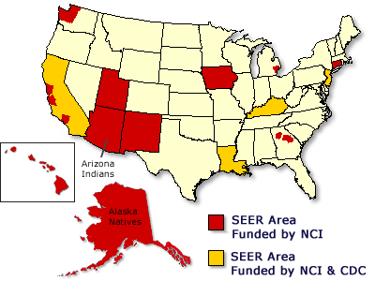
Cancer surveillance
Notes:
21
SEER Areas are areas that are thought to be representative of the larger US Population. These areas makes it possible to follow secular trends over time. In this case it is cancer surveillance by NCI (National Cancer Institute) and CDC (Center for Disease Control).

Slide 22
Three Types of Surveillance
2. Passive Surveillance
Requires (by law) that health care providers to report certain diseases or conditions
Less expensive and troublesome
More common
Results in under-reporting of disease events and media attention and other factors can influence reporting rate
Notes:
22
Passive Surveillance – Involves using data already available on reportable diseases, or the reporting is requested or by law mandatory. Passive Surveillance:
Requires (by law) that health care providers report certain diseases or conditions
Less expensive and troublesome
More common
Results in under-reporting of disease events, because physicians and other health providers do not have/take time to do the reporting. In addition, media attention and other factors can influence reporting rate
Reporting instrument must be brief and simple to minimize under-reporting and lack of completeness of reporting.

Slide 23
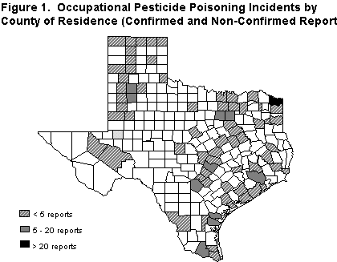
Passive Surveillance
Examples
CDC’s Surveillance of Notifiable Diseases
Adverse Drug Event (ADE) reports to FDA
Reports of poisonings to county and state Departments of Health (see e.g., figure)
Notes:
23
This is an example of passive surveillance of Occupational Pesticide Poisoning Incidents by County of Residence.

Slide 24
Occurrence of SIDS in the US, 1980-96
Notes:
24
SIDS (i.e. Sudden Infant Death Syndrome) is another example of the importance of Passive Surveillance.
It was a sharp drop in occurrence of SIDS after studies showed that the sleeping position was important for SIDS, and public information campaign started.
Some years back, after this information campaign had started, my daughter had her first child and delivered in the University Hospital in Tromso, Norway. When I visited my daughter in the hospital, I found her newborn lying in her little bed, on her back, and on her hospital T-shirt was written on the front: “This side up!”

Slide 25
Three Types of Surveillance
3. Sentinel Surveillance:
“Sentinel Health Events”: events that serve as a warning that a system of health care has failed or is failing.
Least Common
  Example: One or more cases of polio can be a indicator of failed immunization;
  Example: Occurrence of malignant mesothelioma is an indicator of asbestos exposure.
  Example: 1999-2002: Flocks of domestic birds (e.g., chickens) or wild birds (e.g., crows) are monitored to identify West Nile Virus.
Notes:
25
Sentinel (“first case”) Surveillance – is based on selected population samples chosen to represent the relevant experience of particular groups, like HIV/AIDS. Like other forms of surveillance, Sentinel Surveillance also requires standard case definitions and protocols.
Sentinel Events are “first cases” that serve as a warning that a new disease is being introduced, or that a health system has failed or is failing
Least common method of surveillance

Slide 26
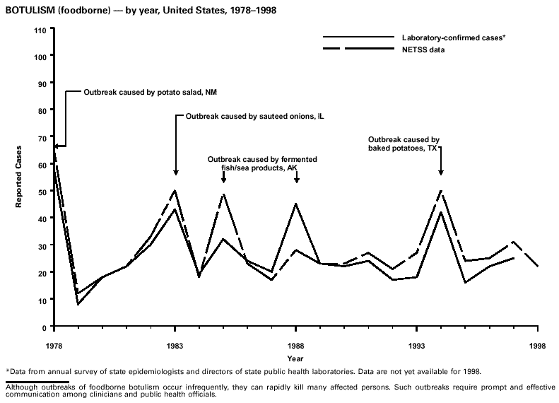
Notes:
26
Occurrence of Botulism is an example of Sentinel Surveillance. Botulism is followed because we know that it is endemic in the US, and we ned to know if a new outbreak occur in order to quickly stop the outbreak. The graph shows outbreaks between 1978 and 1998 caused by contaminated food (potato salad, sauteed onions, fermented fish or sea products, and baked potatoes).

Slide 27
Types of Data Used in Public Health Surveillance
Mortality Data – death rates of diseases
Morbidity Data – incidence and prevalence of diseases
Health Surveys – includes lifestyle data (e.g. NHANES)
  http://www.cdc.gov/nchs/nhanes.htm http://www.cdc.gov/nchs/index.htm
Disease Indicators – uses diseases transmitted from animals
Environmental Monitoring – uses routine monitoring of food, water and air
Drug Monitoring – includes drug utilization
Schools and Employment Data – includes monitoring of records
Notes:
27
Public Health Surveillance uses many types of data, like:
Mortality and morbidity data
Health Surveys, like the NHANES (National Health and Nutrition Examination Survey) “is a program of studies designed to assess the health and nutritional status of adults and children in the United States. The survey is unique in that it combines interviews and physical examinations”. http://www.cdc.gov/nchs/nhanes.htm Data from NHANES and many other surveys are found at the website of National Center for Health Statistics (NCHS) at http://www.cdc.gov/nchs/index.htm
Disease Indicators – of diseases transmitted from animals
Routine Environmental monitoring of food , water and air
Drug utilization Monitoring, and
Data regarding Schools and Employment

Slide 28
Sources of Data used in Public Health Surveillance
Census Data
EVERY 10 YEARS (1790…1990, 2000, 2010)
Age, sex, race, marital status, residence
SUB-GROUPS - additional information
Number of children, education, occupation,
employment status, means of transportation, etc.
SMSA - Standard Metropolitan Statistical Area
A city of at least 50,000 people and surrounding county areas used to develop statistics that can be compared with other SMSA within the U.S.
Notes:
28
Census Data is also used in Public Health Surveillance. However, censuses happens only every 10 years, and young males do not pay much attention to such events, and data on young males in Censuses are usually the least accurate.
While regular census data are limited to age, sex, race, marital status and residence, additional information is gathered on sub-groups.
SMSA or Standard Metropolitan Statistical Area is a city of at least 50,000 people, and surrounding county that is supposed to reflect a broader US population, and therefore is used to develop statistics that can be compared with other US SMSAs.

Slide 29
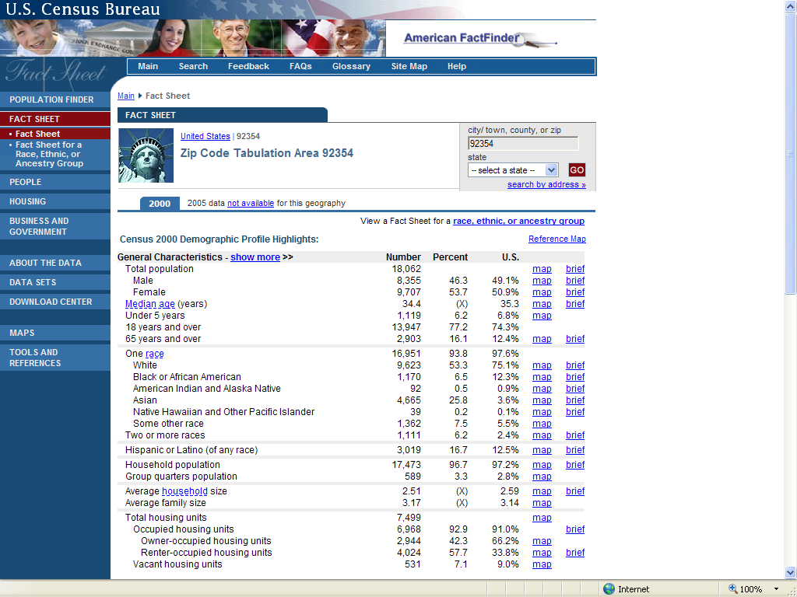
Notes:
29
This is Loma Linda statistics from the 2005 census

Slide 30
Vital Statistics
Maintained by each state using similar formats
Birth Certificates
  name, date, place, parents, ID, birth-weight
Marriage Certificates
Death Certificates – (MD’s & coroner)
  immediate, intervening, underlying cause of death
  NDI (National Death Index) – central source for acqusition of death certificates for the US.
Notes:
30
Vital statistics used in Public Health Surveillance includes data on birth certificates, marriage certificates and death certificates. Birth and marriage certificates usually have precise data. However, death certificates may not have very precise data on the causes of death. During busy days (and nights) the MD on call may simply have to use more resources on the living than the dead. Death Certificates register both immediate, intervening and contributory causes of death:
Immediate cause of death, is the direct cause of death (e.g. Ventricular Fibrillation).
Intervening cause of death is a contributory cause (e.g. CHD)
Underlying cause of death is a condition (disease) that “adds to the other problems” (e.g. Diabetes)

Slide 31
Disease Registries
Special databases that contains information about people diagnosed with a specific type of disease.
  Hospital based - contains data on all the patients with a specific type of disease diagnosed and treated at that hospital.
  Population based - contains records for people diagnosed with a specific type of disease who reside within a defined geographic region.
    HIV
    Tuberculosis
    Cancer
Notes:
31
Disease Registries contains information about individuals diagnosed with a specific disease. These registries may be either hospital or public based:
Hospital based registries usually contains data on all the patients with a specific disease that are diagnosed and treated at that hospital
Population based registries normally contains records of individuals diagnosed with a specific disease that is of special public interest, and who resides in a defined geographic area. Examples of population based disease registries are:
HIV
Tuberculosis
Cancer

Slide 32
CDC Surveillance Reports
Surveillance of incidence (new cases)
Weekly monitoring of “notifiable” diseases
Updates and reports on special disease issues
Publication of MMWR
  (Morbidity and Mortality Weekly Report)
  http://www.cdc.gov/mmwr/
Notes:
32
This is examples of Surveillance reports from CDC. The Norwegian version of the MMWR (the Morbidity and Mortality Weekly Report) I used to read when I was working in hospital setting, because it drew my attention to diseases that was prevalent in the community, and that I probably would have to deal with as part of my job.

Slide 33


Data Sources
National Center for Health Statistics
  http://www.cdc.gov/nchs/deaths.htm
  http://www.cdc.gov/nchs/products/pubs/pubd/series/ser.htm
http://www.fedstats.gov/
http://www.whitehouse.gov/fsbr/ssbr.html
http://www.cdc.gov/nchs/sites.htm
http://www.cancer.org/docroot/STT/stt_0.asp
Notes:
33
Governmental (NCHS) data sources for some health statistics.

Slide 34
Special Surveys
Surveillance of risk factors
National Health Interview Survey (NHIS)
  Representative sample of US Population is questioned about health status, including self-reported disease.
National Health and Nutrition Examination Survey (NHANES)
  Extensive physical exam and dietary history of “representative” sample of US population.
Health Records Survey
  Existing medical records in different regions, gives information on regional differences.
Notes:
34
This slide shows some examples of special surveys used in surveillance of risk factors. You are not required to remember all this information of the different surveys mentioned, but especially the NHANES study you will be exposed to during this course and in your health profession because it is so often reported from in the literature.
NHANES was borne out of the National Health Survey Act of 1965. It is a continuing National Health Survey, gathering information on Health Status and services received because of health conditions. It is done by NCHS (the National Center for Health Statistics).

Slide 35
Causes of death in 1900 and 1990
1900
1990
1. Pneumonia 12%
2. Tuberculosis 11%
3. Diarrhea, etc 8%
4. Heart disease 8%
1. Heart disease 34%
2. Cancer 24%
3. Stroke 7%
4. Unintentional
Injuries 4%
47 yrs
Life expectancy
75 yrs
Notes:
35
In 1900 people mainly died from infections diseases, and heart disease was number 4 on the list causing only 8% of deaths.
In 1990, however, the infectious diseases is far down the list, and heart disease, cancer and stroke are now the leading causes of death in the US.
From 1900 to 1990 life expectancy has increased from 47 years to 75 years, and it has continued to increase since then. The main reason for this change in life expectancy is that many children around 1900 died from infectious diseases. Their contribution to lower life expectancy obviously was much higher than older people who died from infectious diseases. Now children survive to much older age, and even older people live longer than earlier.

Slide 36
Death rates and life expectancy by race and gender.
US 2006
 | All races | White | Black
Age-adjusted death rate¹ | 776.5 | 764.4 | 982.0
Male | 924.8 | 908.2 | 1,215.6
Female | 657.8 | 648.2 | 813.0
Yrs of life expectancy at birth | 77.7 | 78.2 | 73.2
Male | 75.1 | 75.7 | 69.7
Female | 80.2 | 80.6 | 76.5
Maternal mortality rate (2002)² | 13.3 (8.9) | 9.5 (6.0) | 32.7 (24.9)
Infant mortality rate² | 6.69 | 5.56 | 13.29
¹ Per 100,000
² Per 1,000
National Death Index at www.cdc.gov/nchs/ndi.htm
Notes:
36
You will now be exposed to some slides that deals with death rates, morbidities and life expectancies. This is data from the National Death Index (NCHS), showing age-adjusted death rates per 100,000 population, and maternal mortality and infant mortality per 1,000 population. Obviously, there are large differences in the rates between blacks and whites. How would you explain these differences?

Slide 37
Births US 2004
Race of mother | Number | Birth rate | Fertility rate
All races and origins | 4,115,590 | 14.0 | 66.3
Non-Hispanic white | 2,304,181 | 11.7 | 58.5
Non-Hispanic black | 578,105 | 15.1 | 66.7
American Indian total | 43,931 | 14.0 | 58.9
Asian or Pacific Islander total | 229,352 | 16.8 | 67.2
Hispanic | 944,993 | 55.9 | 97.7
Notes:
37
Total births and percentage of births with selected demographic characteristics, by race and Hispanic origin of mother: United States, 2004. How do you explain the large difference between birth rate and fertility rate among Hispanics as compared to the other racial groups in the US?

Slide 38
Infant, Neonatal and Postneonatal Death Rates¹, US
 | 2006 |  |  | 2003
 | All races | White | Black | All races | White | Black
Infant
Total | 6.69 | 5.56 | 13.29 | 6.85 | 5.72 | 14.01
Male | 7.32 | 6.10 | 14.38 | 7.60 | 6.36 | 15.53
Female | 6.03 | 4.99 | 12.16 | 6.07 | 5.05 | 12.43
Neonatal
Total | 4.45 | 3.72 | 8.82 | 4.62 | 3.87 | 9.40
Male | 4.84 | 4.05 | 9.49 | 5.08 | 4.26 | 10.40
Female | 4.05 | 3.37 | 8.12 | 4.14 | 3.46 | 8.37
Postneonatal
Total | 2.24 | 1.84 | 4.47 | 2.23 | 1.84 | 4.60
Male | 2.48 | 2.05 | 4.89 | 2.52 | 2.09 | 5.13
Female | 1.98 | 1.62 | 4.04 | 1.94 | 1.58 | 4.06
¹Rates are infant (under 1 year), neonatal (under 28 days), and postneonatal (28 days-11 months) deaths per 1,000 live births
National Death Index. www.cdc.gov/nchs/ndi.htm
Notes:
38
According to this slide, the Infant, neonatal and post-neonatal death rates have not changed much from 2003 to 2006, but the rates are quite different between blacks and whites in the US. What can explain these differences?

Slide 39
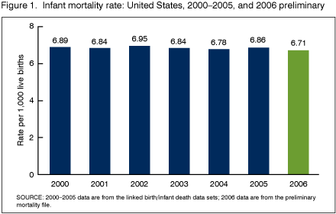
National Death Index at www.cdc.gov/nchs/data/databriefs/db09.htm
Notes:
39
This figure seems to indicate little change in infant mortality in the US from 2000 to 2006. However, 2006 seem to be lower than previous years. Would you expect infant mortality rate to decline further in the US over the next 10 years, and how do you explain your answer?

Slide 40
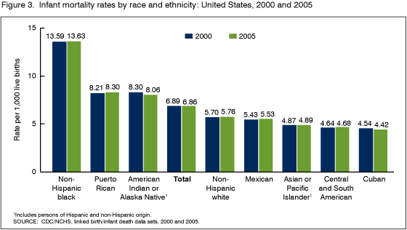
National Death Index at www.cdc.gov/nchs/data/databriefs/db09.htm
Notes:
40
This figure show infant mortality in the US in 2000 and 2006. There are large variations between different racial groups. Why do you think that is the case? A website to the data is given.

Slide 41
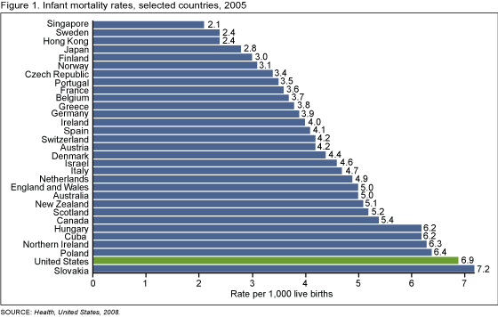
National Death Index at www.cdc.gov/nchs/data/databriefs/db23.htm
Notes:
41
In 2004 US ranked 29th in the world in infant mortality, tied with Poland and Slovakia.
Lowest (below 3.5/1,000) is seen in Scandinavian countries (i.e. Finland, Norway, Sweden) and East Asian countries (i.e. Japan, Hong Kong, Singapore).
US ranking fell from 12th in 1960 to 23d in 1990, and 29 in 2004. What may explain these differences in infant mortality between countries, and why has the US ranking dropped over the years?

Slide 42
Gestational age-specific infant mortality rates, United States and selected European countries, 2004
Selected countries | 22-23 weeks¹ | 24-27 weeks | 28-31 weeks | 32-36 weeks | 37 weeks or more
United States | 707.7 | 236.9 | 45.0 | 8.6 | 2.4
Austria | 888.9 | 319.6 | 43.8 | 5.8 | 1.5
Denmark | 947.4 | 301.2 | 42.2 | 10.3 | 2.3
England and Wales² | 880.5 | 298.2 | 52.2 | 10.6 | 1.8
Finland | 900.0 | 315.8 | 58.5 | 9.7 | 1.4
Northern Ireland | 1,000.0 | 268.3 | 54.5 | 13.1 | 1.6
Norway | 555.6 | 220.2 | 56.4 | 7.2 | 1.5
Poland | 921.1 | 530.6 | 147.7 | 23.1 | 2.3
Scotland | 1,000.0 | 377.0 | 60.8 | 8.8 | 1.7
Sweden | 515.2 | 197.7 | 41.3 | 12.8 | 1.5
¹ Infant mortality rates at 22-23 weeks of gestation may be unreliable due to reporting differences.
² England and Wales provided 2005 data.
NOTE: Infant mortality rates are per 1,000 live births in specified group.
SOURCE: NCHS linked birth/infant death data set (for U.S. data), and European Perinatal Health Report (for European data).
National Death Index at www.cdc.gov/nchs/data/databriefs/db23.htm
Notes:
42
What differences du you see regarding gestational age-specific infant mortality rates between the US and selected European countries?

Slide 43
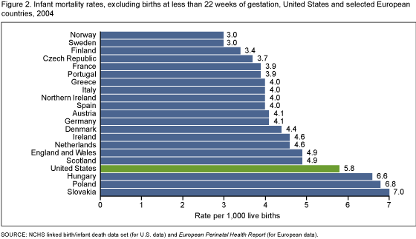
National Death Index at www.cdc.gov/nchs/data/databriefs/db23.htm
When births less than 22 weeks were excluded, the U.S. infant mortality rate dropped from 6.8
To 5.8 infant deaths per 1,000 live births in 2004
Notes:
43
In this graph births less than 22 weeks are excluded, and the US infant mortality rate dropped from 6.5 to 5.8 per 1,000 live births in 2004.

Slide 44
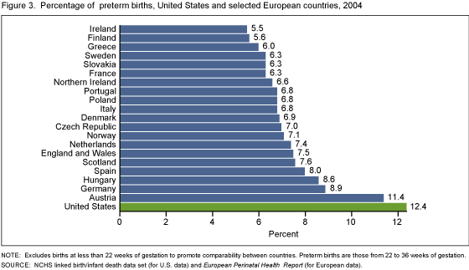
National Death Index at www.cdc.gov/nchs/data/databriefs/db23.htm
Notes:
44
According to this graph, the percentage of preterm births are much higher in the US as compared to many European countries. Why is that the case?

Slide 45
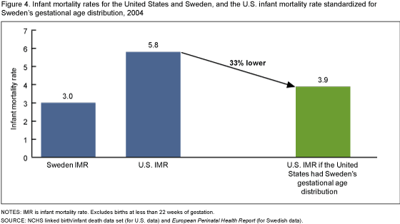
National Death Index at www.cdc.gov/nchs/data/databriefs/db23.htm
The main cause of the high infant mortality in the U.S. when compared with Europe is the very
high percentage of preterm birhts in the U.S.
Notes:
45
This figure indicate that the main cause of the high infant mortality in the US when compared to Europe, is the very high percentage of preterm births in the US. What do you think is the risen for this difference in preterm births?

Slide 46
Births and Fertility
Number of live births in a population
during a specified time period
Birth “rate”
=
X 1,000
Population size at the
middle of that period
Number of live births in a population
during a specified time period
Fertility “rate”
=
X 1,000
Population of women
ages 15-44 years
Notes:
46
You are not required to remember all these definitions for the exams. I will let you know the few you should remember.

Slide 47
Mortality
Number of infant deaths among infants
ages 0-1 years during the year
Infant mortality
=
X 1,000
Number of live births
during the year
Neonatal (birth to 28 days of life)
Postneonatal (28 days to 1 year of life)
Number of fetal deaths
after 20 weeks gestation
Fetal death “rate”
=
X 1,000
Number of live births + fetal deaths
Notes:
47

Slide 48
Mortality
Number of deaths occurring
during a given time period
Mortality “rate”
=
X 100,000
Population from which deaths occurred
Number of deaths from a specific cause
occurring during a given time period
Cause-Specific
Mortality “rate”
=
X 100,000
Population from which deaths occurred
Notes:
48
These definitions you should remember.
Mortality “rate” is also called Crude Mortality “rate”. “Rate” is in quotation marks because this is not a true rate. We will come back to that later.
Cause-specific Mortality “rate” is not a true rate either. However, thy have been called rates for many years.

Slide 49
Surveillance of Deaths
YPLL
  Years of Potential Life Lost
  Years of Potential Life Lost before 75 years
  For example, persons who die at age 65 are considered to have lost 10 “potential” years of life.
  Children who die at age 10 are considered to have lost 65 “potential” years of life.
Notes:
49
Years of Potential Life Lost (YPLL) is a measure that is increasingly used in epidemiology to characterize the size of health problems. This measure is up to each study to define. Some define YPLL before age 65 years, or 70 years. For this class I have decided to use 75 years as the cut-off point because of the life expectancy we have in the US today.

Slide 50
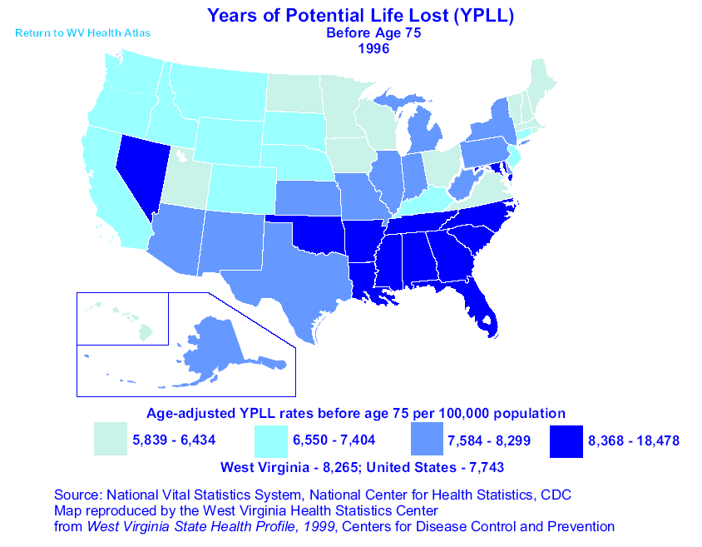
Notes:
50
The south-eastern US states have a much higher YPLL than other parts of the country. This is mainly because of the higher CVD rates in this area, which is called “the Stroke belt”.

Slide 51
Leading causes of YPLL<75* in the US in 2013 per 100,000
Cancer . . . . . . . . . . . . . . . . . . . . . . 1,395.8
Unintentional injuries . . . . . . . . . . . 1,025.2
Ischemic Heart Disease . . . . . . . . . 577.3
Suicide . . . . . . . . . . . . . . . . . . . . . . . 385.2
*Age-adjusted
National Center for Health Statistics
http://www.cdc.gov.nchs/data/hus/hus13.pdf#summary
Notes:
51
This is leading causes of Years of Potential Life Lost in the US in 2013. Cancer and unintentional injuries are at the top of the list.

Slide 52
US Mortality, 2010
Rank | Causes of Death (based on ICD-10) | No. of Deaths | % of all Deaths
1 | Heart Diseases (I00-I09, I11-I13, I20-I51) | 597,689 | 24.2
2 | Cancer (C00-C97) | 574,743 | 23.3
3 | Chronic Lower Respiratory Disease (J40-J47) | 138,080 | 5.6
4 | Cerebrovascular Diseases (I60-I69) | 124,476 | 5.2
5 | Accidents (Unint. Injury) (V01-X59, Y85-Y86) | 120,856 | 4.9
6 | Alzheimer’s Disease (G30) | 83,494 | 3.4
7 | Diabetes Mellitus (E10-E14) | 69,071 | 2.8
8 | Nephritis, Nephrotic Syndrome and Nephrosis (N00-N07, N17-N19, N25—N27) | 50,476 | 2.0
9 | Influenza and Pneumonia (J09-J18) | 50,097 | 2.0
10 | Suicide (U03, X60-X84, Y87.0) | 38,364 | 1.6
Source: National Center for Health Statistics, Centers for Disease Control and Prevention, 2014.
http://www.cdc.gov/nchs/data/nvsr/nvsr61/nvsr61_04.pdf
Notes:
52
Cancer accounts for nearly one-quarter of deaths in the United States, exceeded only by heart diseases. In 2010, there were almost 600,000 heart disease deaths in the US, and almost 575,000 cancer deaths. However, heart disease mortality has been declining over many years, while cancer mortality has been increasing.
http://www.cdc.gov/nchs/data/nvsr/nvsr61/nvsr61_04.pdf

Slide 53
2014 Estimated US Cancer Deaths*
Lung & bronchus 28%
Prostate 10 %
Colon & rectum 8 %
Pancreas 7%
Leukemia 5%
Liver & intrahepatic 5%
bile duct
Esophagus 4%
Urinary bladder 4%
Non-Hodgkin 3% lymphoma
Kidney 3%
All other sites 23%
Men
310,010
Women
275,710
26% Lung & bronchus
15% Breast
9% Colon & rectum
7% Pancreas
5% Ovary
4% Leukemia
3% Non-Hodgkin
lymphoma
3% Uterine corpus
3% Liver & intrahepatic
bile duct
2% Brain/ONS**
23% All other sites
*Excludes basal and squamous cell skin cancers and in situ carcinomas except urinary bladder.
Source: American Cancer Society, 2014. **Other Nervous Tissue
http://www.cancer.org/acs/groups/content/@research/documents/webcontent/acspc-042151.pdf
Notes:
53
Lung cancer is, by far, the most common fatal cancer in men (28%), followed by prostate (10%), and colon & rectum (8%). In women, lung (26%), breast (15%), and colon & rectum (9%) are the leading sites of cancer death.
http://www.cancer.org/acs/groups/content/@research/documents/webcontent/acspc-042151.pdf

Slide 54
Cancer Death Rates*, for Men, US,1930-2002
Rate Per 100,000
Lung
Stomach
Prostate
Colon & rectum
Pancreas
Leukemia
Liver
*Age-adjusted to the 2000 US standard population.
Source: US Mortality Public Use Data Tapes 1960-2002, US Mortality Volumes 1930-1959,
National Center for Health Statistics, Centers for Disease Control and Prevention, 2005.
Notes:
54
Most of the increase in cancer death rates for men prior to 1990 was attributable to lung cancer. However, since 1990, the age-adjusted lung cancer death rate in men has been decreasing. Stomach cancer mortality has decreased considerably since 1930. Death rates from prostate and colorectal cancers have also been declining.

Slide 55
Cancer Death Rates*, for Women, US,1930-2002
Rate Per 100,000
Lung
Uterus
Breast
Colon & rectum
Stomach
Ovary
Pancreas
*Age-adjusted to the 2000 US standard population.
Source: US Mortality Public Use Data Tapes 1960-2002, US Mortality Volumes 1930-1959,
National Center for Health Statistics, Centers for Disease Control and Prevention, 2005.
Notes:
55
Lung cancer is currently the most common cause of cancer death in women, with the death rate more than two times what it was 25 years ago. In comparison, breast cancer death rates were virtually unchanged between 1930 and 1990, and have since decreased on average 2.3% per year. The death rates for stomach and uterine cancers have decreased steadily since 1930; colorectal cancer death rates have been decreasing for over 50 years.

Slide 56
Cancer Death Rates*, by Race and Ethnicity, US,1998-2002
*Per 100,000, age-adjusted to the 2000 US standard population.
†Hispanic is not mutually exclusive from whites, African Americans, Asian/Pacific Islanders, and American Indians/
Alaska Natives.
Source: Surveillance, Epidemiology, and End Results Program, 1975-2002, Division of Cancer Control and
Population Sciences, National Cancer Institute, 2005.
Notes:
56
Overall, cancer death rates are higher in men than women in every racial and ethnic group. African American men and women have the highest rates of cancer mortality. Asian and Pacific Islander men and women have the lowest cancer death rates, about half the rate of African American men and women, respectively.
Note: Rates for populations other than white and African American may be affected by problems in ascertaining race/ethnicity information from medical records. This is likely to result in reported death rates that are lower than true death rates.

Slide 57
Cancer Death Rates* by Sex and Race, US, 1975-2002
Rate Per 100,000
African American men
White men
African American women
White women
*Age-adjusted to the 2000 US standard population.
Source: Surveillance, Epidemiology, and End Results Program, 1975-2002, Division of Cancer Control and
Population Sciences, National Cancer Institute, 2005.
Notes:
57
Overall, cancer death rates are higher in African-American men than white men and in African-American women than white women. However, the cancer death rate is declining faster in African-American men than white men.

Slide 58
2014 Estimated new US Cancer Cases*
Men
855,220
Women
810,320
Prostate 27%
Lung & bronchus 14%
Colon & rectum 8%
Urinary bladder 7%
Melanoma of skin 5%
Kidney, renal pelvis 5%
Non-Hodgkin 4% lymphoma
Oral cavity, pharynx 4%
Leukemia 4%
Liver, intrahep. duct 3%
All Other Sites 19%
29% Breast
13% Lung & bronchus
8% Colon & rectum
6% Uterine corpus
6% Thyroid
4% Non-Hodgkin
lymphoma
4% Melanoma of skin
3% Kidney, renal pelvis
3% Pancreas
3% Leukemia
21% All Other Sites
*Excludes basal and squamous cell skin cancers and in situ carcinomas except urinary bladder.
Source: American Cancer Society, 2014.
http://www.cancer.org/acs/groups/content/@research/documents/webcontent/acspc-042151.pdf
Notes:
58
Now we will turn our attention to the number of new cancers anticipated in the US this year. It is estimated that almost 1.7 million new cases of cancer will be diagnosed in 2014. Cancers of the prostate and breast will be the most frequently diagnosed cancers in men and women, respectively, followed by lung and colorectal cancers both in men and in women.
http://www.cancer.org/acs/groups/content/@research/documents/webcontent/acspc-042151.pdf

Slide 59
Cancer Incidence Rates* for Men, 1975-2002
Rate Per 100,000
Prostate
Lung
Colon and rectum
Urinary bladder
Non-Hodgkin lymphoma
Melanoma of the skin
*Age-adjusted to the 2000 US standard population.
Source: Surveillance, Epidemiology, and End Results Program, 1975-2002, Division of Cancer Control and
Population Sciences, National Cancer Institute, 2005.
Notes:
59
Between 1988 and 1992, prostate cancer incidence rates increased dramatically due to early diagnosis with prostate-specific antigen (PSA) blood testing, after increasing steadily from 1975 to 1988. Incidence rates for both lung and colorectal cancers in men have declined in recent years.

Slide 60
Cancer Incidence Rates* for Women, 1975-2002
Rate Per 100,000
Breast
Colon and rectum
Lung
Ovary
Uterine Corpus
Non-Hodgkin lymphoma
*Age-adjusted to the 2000 US standard population.
Source: Surveillance, Epidemiology, and End Results Program, 1975-2002, Division of Cancer Control and
Population Sciences, National Cancer Institute, 2005.
Notes:
60
In women, breast cancer incidence rates increased rapidly in the 1980s due to increased use of mammography, and have increased gradually since that time. During the most recent time period (1998-2002), incidence rates of lung cancer have leveled off, while rates of colorectal cancer have decreased.

Slide 61
Summary
Key points:
Calculate mortality and natality rates
Identify sources of data
Explain the different types of surveillance
Notes:
61

